Slide 1
MAS-GPT: Training LLMs to build LLM-based multi-agent systems Authors: Rui Ye, Shuo Tang, Rui ge, Yaxin Du, Zhenfei Yin, Siheng Chen, Jing Shao Presented by: maha Zainab

Slide 2
Agenda
Motivation
Research Contribution
Challenges
Methodology
Framework
Results
Strengths and Weaknesses
Extension

Slide 3
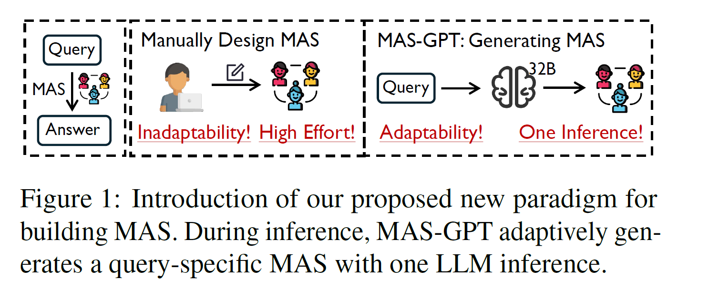

Slide 4
Motivation
LLMs: Struggle with complex, multi-step, or domain-diverse tasks
Multi-Agent Systems: Multiple LLMs to collaborate, improving reasoning and task decomposition.
Manually Designed, Costly, and Static
To automate MAS construction by enabling an LLM to generate executable multi-agent systems dynamically

Slide 5
Research Contributions
1. We reframe building MAS for each query as a generative language task. We unify the representation of MAS as executable code and propose a consistency-oriented query-MAS data construction pipeline for LLM training.
2. We introduce MAS-GPT, an LLM specifically trained to generate query-specific executable MAS. All code, data and models will be open-sourced.
3. Experiments on 9 benchmarks and 5 LLMs show that MAS-GPT consistently outperforms 10+ baselines, indicating its effectiveness, efficiency, and generalization ability.

Slide 6
Challenges
The limited knowledge of LLMs on the task of MAS generation
and the lack of corresponding training data.
How to represent the MAS
How to construct the dataset

Slide 7
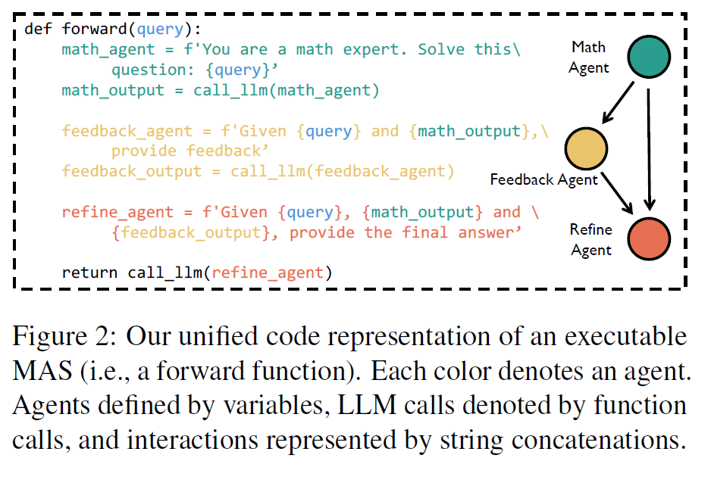
Methodology
User query: a multiagent system (MAS) is constructed
Multiple agents working collaboratively to generate the final answer.

Slide 8
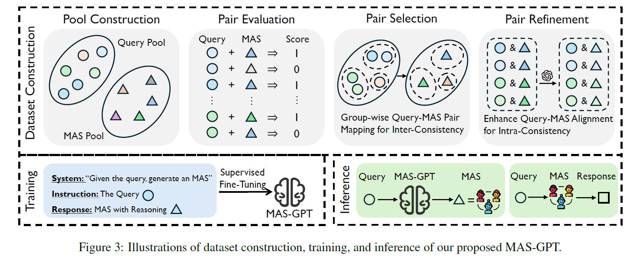
Framework

Slide 9
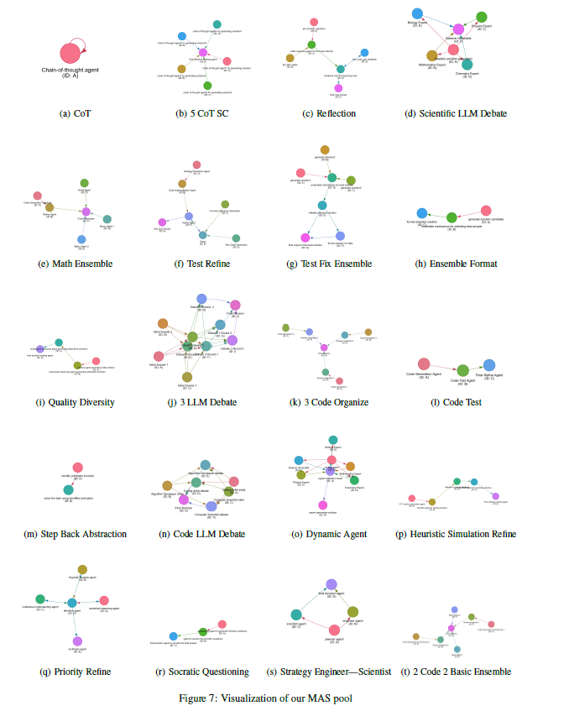

Slide 10
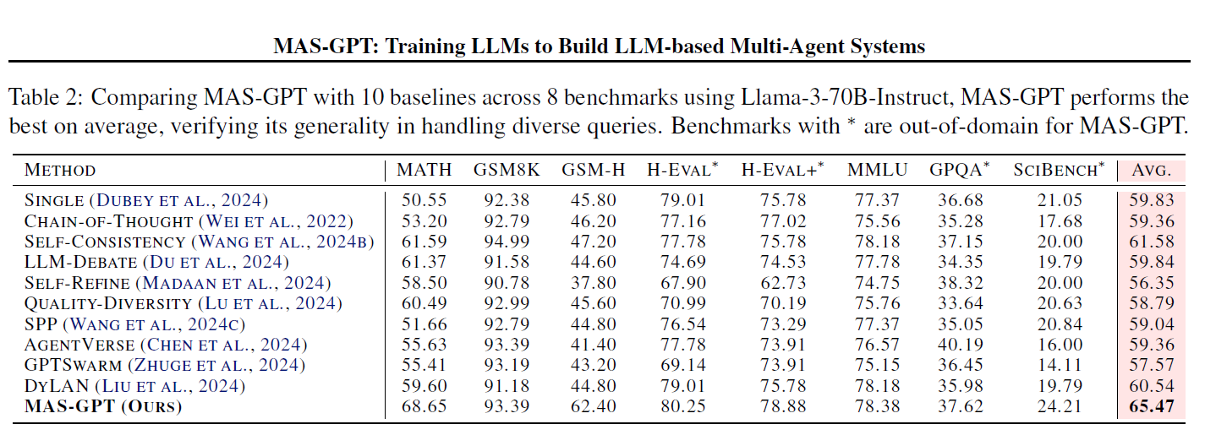
Results

Slide 11
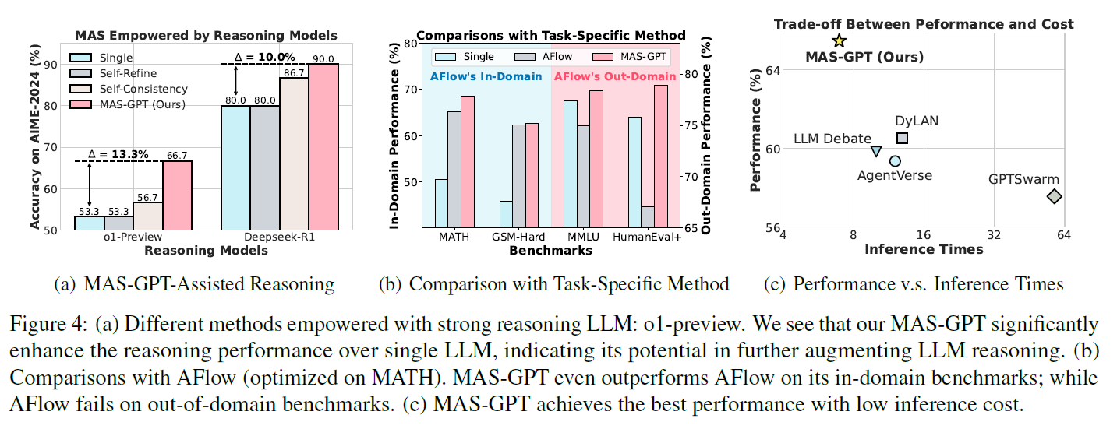
Results

Slide 12
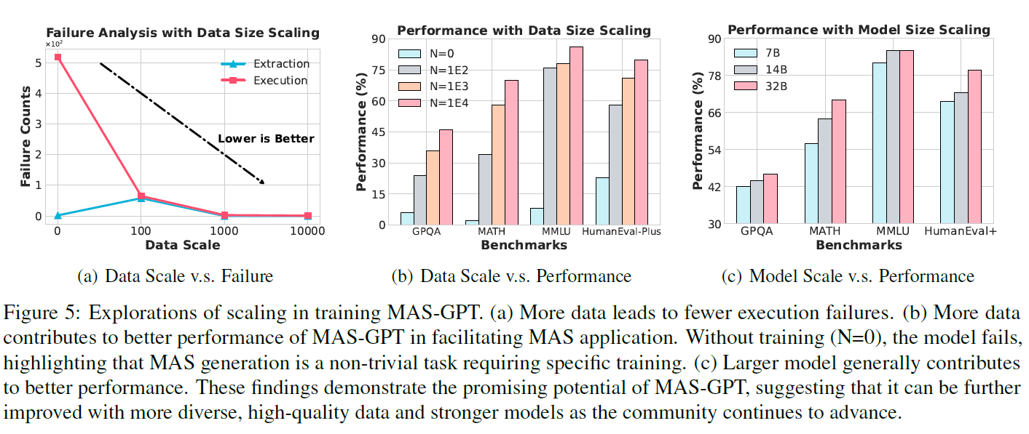
Results

Slide 13
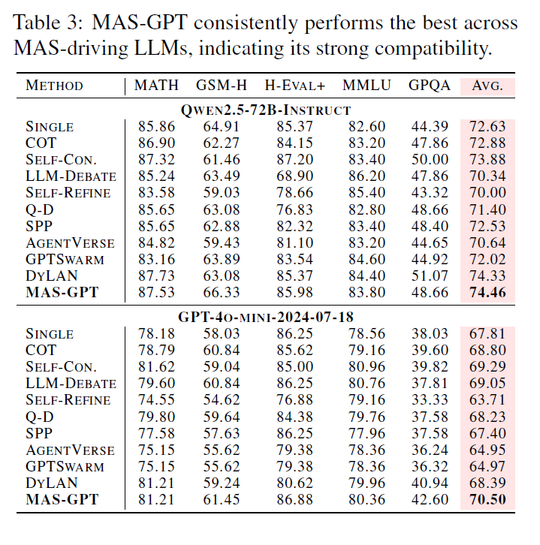
Generality

Slide 14
Strengths Weaknesses
Thorough experiments with diverse benchmarks and backbones validate the generality and effectiveness of MAS-GPT.
MAS-GPT significantly reduces the complexity of designing and deploying MAS for a wide range of tasks.
Most the performance improvement seems coming from the GSM-H dataset. Improvements on other datasets are small and seems randomness.

Slide 15

Extension
Integrate Reinforcement : MAS-GPT generates an entire MAS system once per query, no iterative correction or adaptation.
Add reinforcement learning or self-improving feedback loops where MAS-GPT evaluates and revises its generated systems based on performance or feedback.
Self-evaluate
Self Correct

Slide 16

THANK YOU
Any questions?

